Slide 1


Slide 2

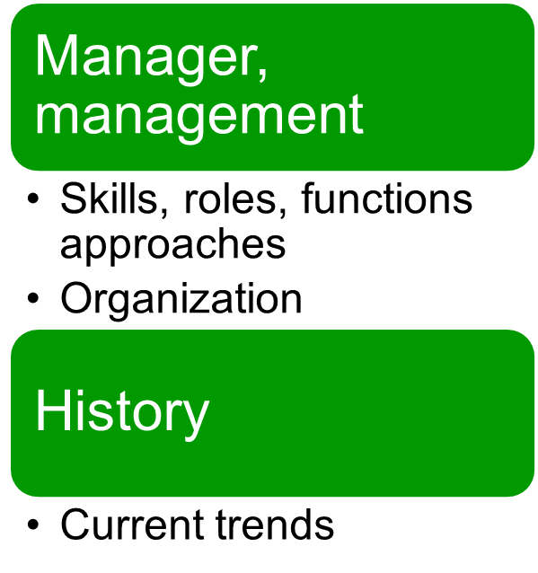
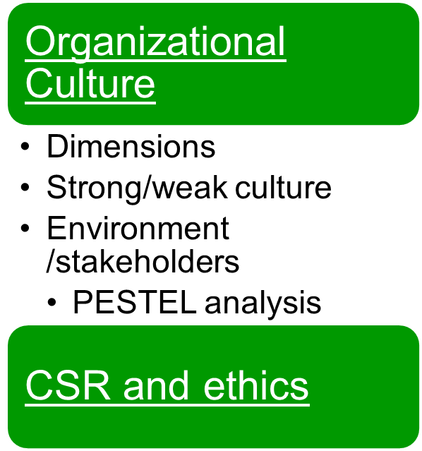
© 2007 Prentice Hall, Inc. All rights reserved.
6–<number>

Slide 3
Decision-Making: The Essence of the Manager’s Job
Chapter
6
© 2007 Prentice Hall, Inc.
All rights reserved.

Slide 4
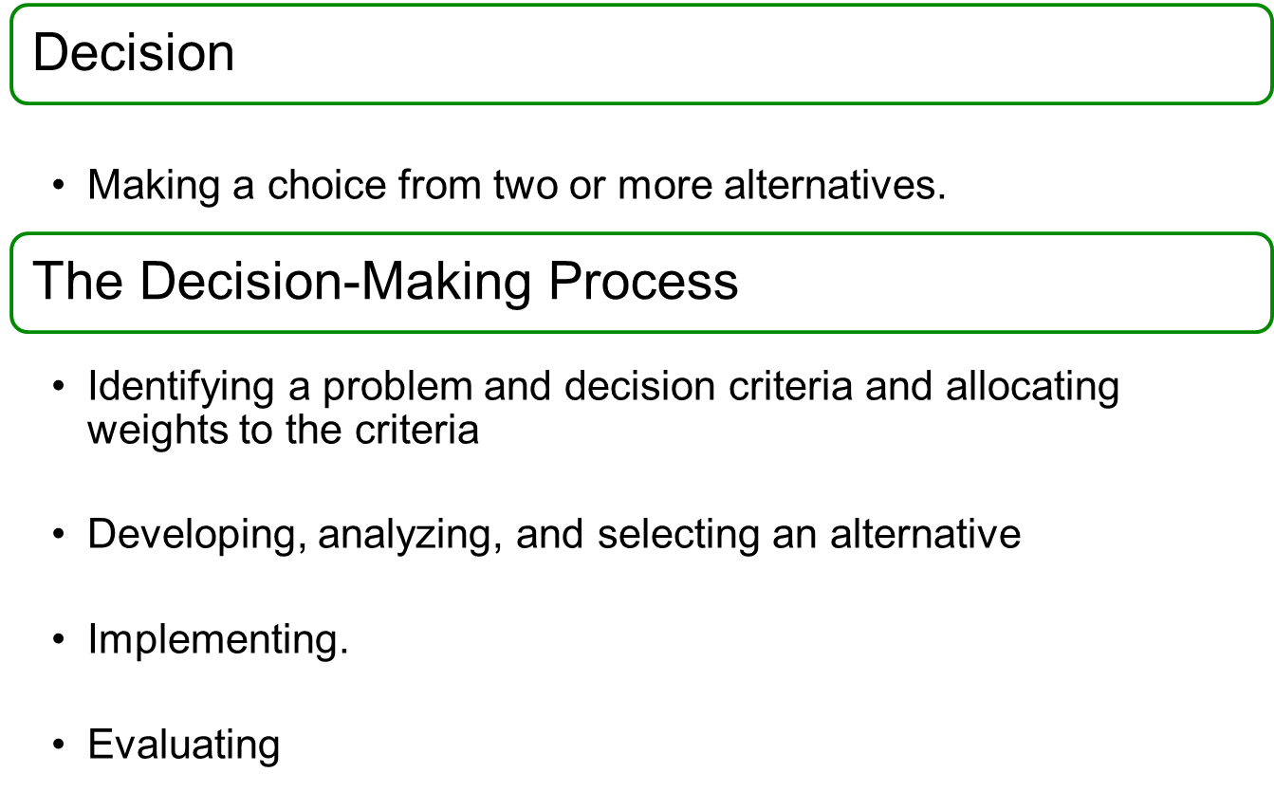
6–<number>

Slide 5
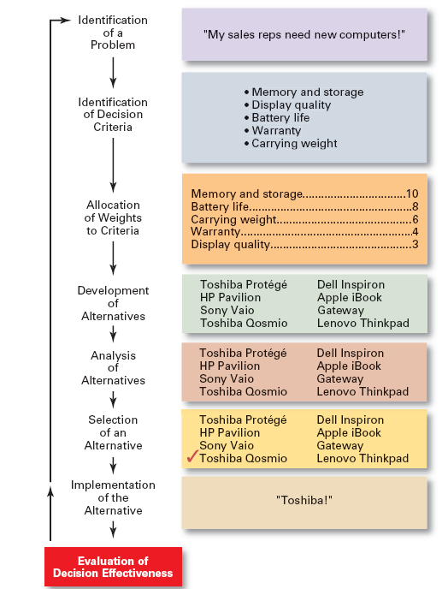
Exhibit 6–1
The Decision-Making Process
© 2007 Prentice Hall, Inc. All rights reserved.
6–<number>

Slide 6
Step 2: Identifying Decision Criteria
  Costs
  Risks
  Outcomes
Step 3: Allocating Weights to the Criteria
Criterion Weight
Memory and Storage 10
Battery life 8
Carrying Weight 6
Warranty 4
Display Quality 3
6–<number>

Slide 7
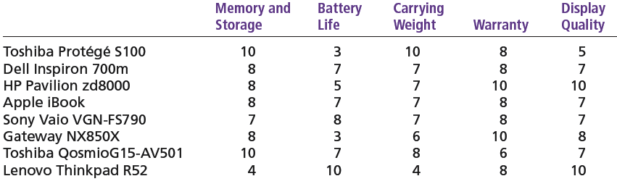
Step 4: Developing Alternatives
Step 5: Analyzing Alternatives
strengths and weaknesses
© 2007 Prentice Hall, Inc. All rights reserved.
6–<number>

Slide 8

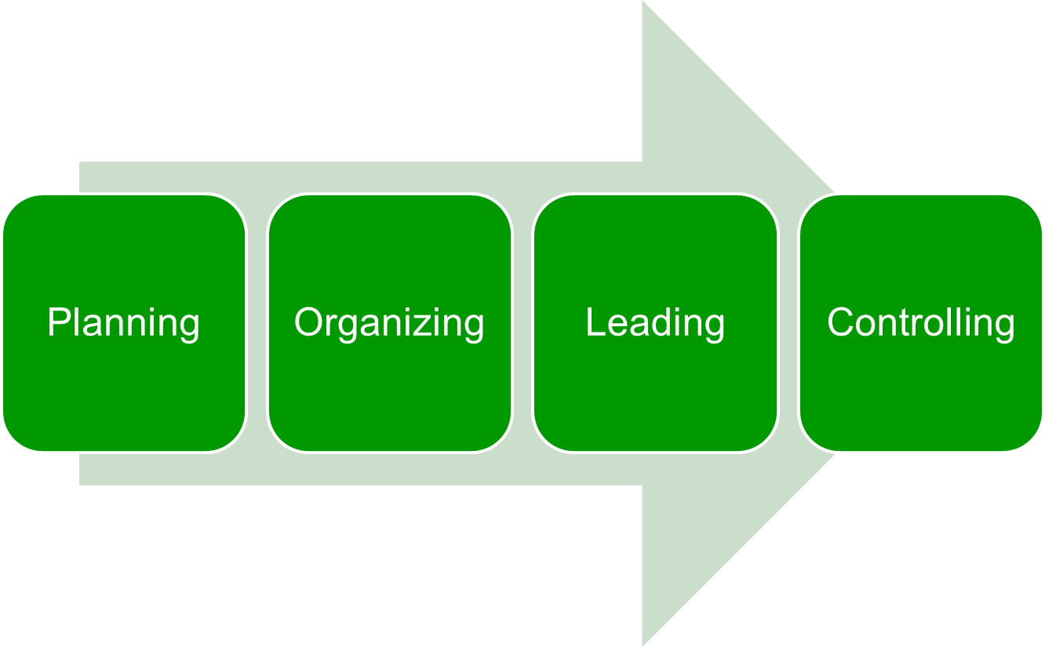
6–<number>

Slide 9
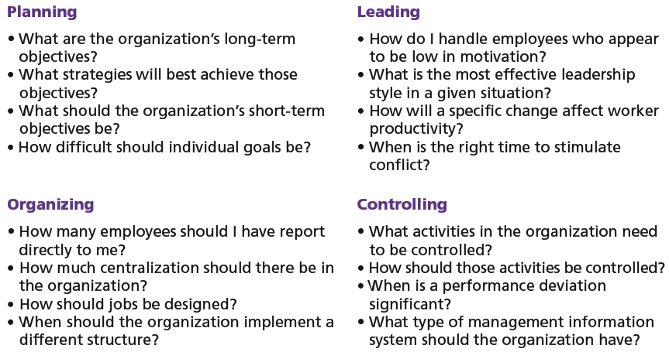
Exhibit 6–5 Decisions in the Management Functions
© 2007 Prentice Hall, Inc. All rights reserved.
6–<number>

Slide 10

  Managers make consistent, value-maximizing choices with specified constraints.
  Assumptions
    Are perfectly rational, fully objective, and logical.
    Have carefully defined the problem and identified all viable alternatives.
    Have a clear and specific goal
    Will select the alternative that maximizes outcomes in the organization’s interests rather than in their personal interests.
Bounded Rationality
  Managers make decisions rationally, but are limited (bounded) by their ability to process information
© 2007 Prentice Hall, Inc. All rights reserved.
6–<number>

Slide 11
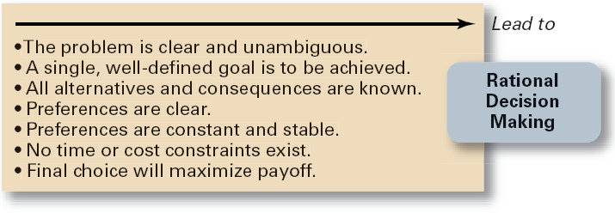
Exhibit 6–6 Assumptions of Rationality
© 2007 Prentice Hall, Inc. All rights reserved.
6–<number>

Slide 12
The Role of Intuition
Intuitive decision making
  Making decisions on the basis of experience, feelings, and accumulated judgment.
© 2007 Prentice Hall, Inc. All rights reserved.
6–<number>

Slide 13
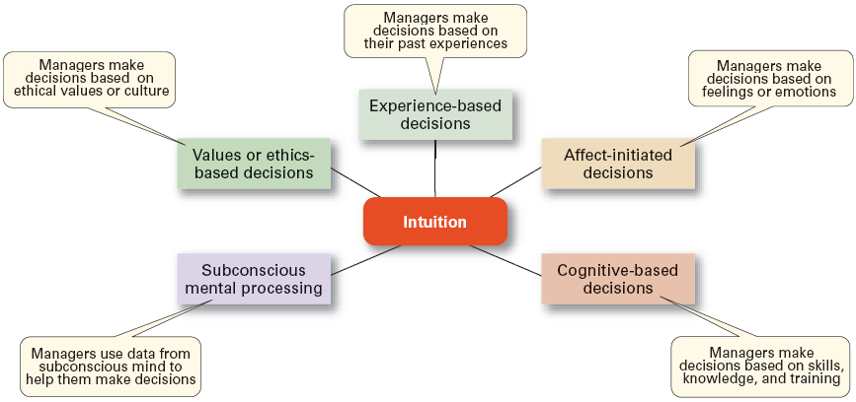
Exhibit 6–7 What is Intuition?
Source: Based on L. A. Burke and M. K. Miller, “Taking the Mystery Out of Intuitive Decision Making,” Academy of Management Executive, October 1999, pp. 91–99.
© 2007 Prentice Hall, Inc. All rights reserved.
6–<number>

Slide 14
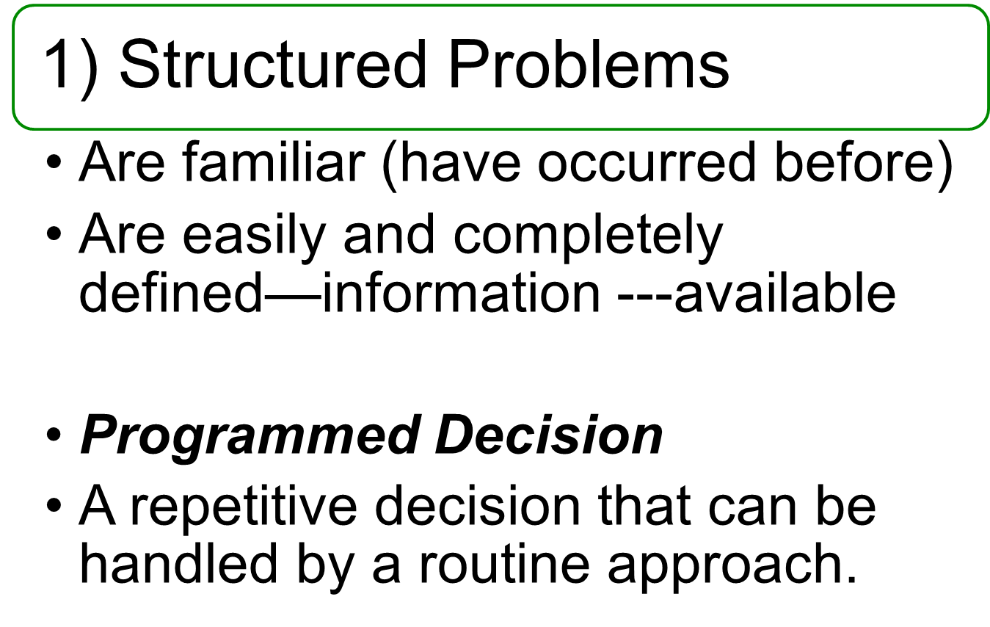
© 2007 Prentice Hall, Inc. All rights reserved.
6–<number>

Slide 15
Types of Programmed Decisions
Policy
  A general guideline for making a decision about a structured problem.
Procedure
  A series of interrelated steps that a manager can use to respond (applying a policy) to a structured problem.
Rule
  An explicit statement that limits what a manager or employee can or cannot do.
© 2007 Prentice Hall, Inc. All rights reserved.
6–<number>

Slide 16
Policy, Procedure, and Rule Examples
Policy
  Accept all customer-returned merchandise.
Procedure
  Follow all steps for completing merchandise return documentation.
Rules
  Managers must approve all refunds over $50.00.
  No credit purchases are refunded for cash.
© 2007 Prentice Hall, Inc. All rights reserved.
6–<number>

Slide 17
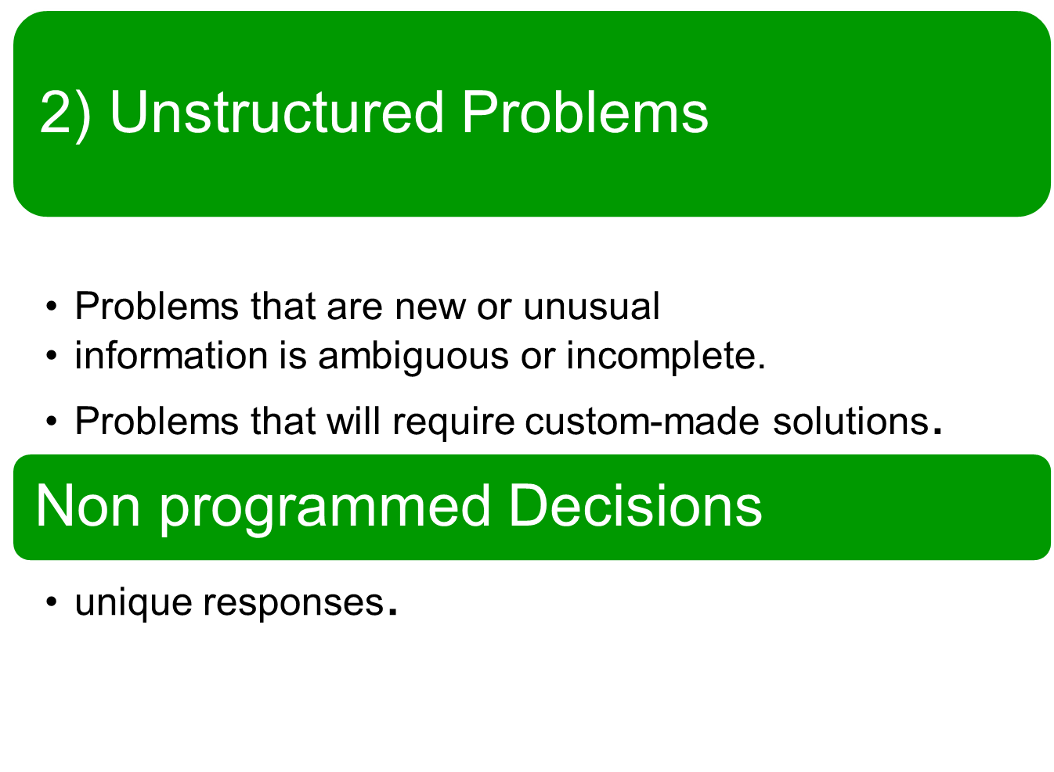
© 2007 Prentice Hall, Inc. All rights reserved.
6–<number>

Slide 18
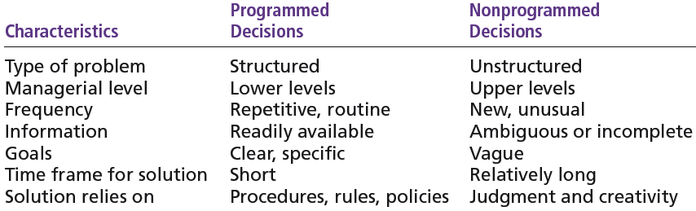
Exhibit 6–8 Programmed versus Nonprogrammed Decisions
© 2007 Prentice Hall, Inc. All rights reserved.
6–<number>

Slide 19

© 2007 Prentice Hall, Inc. All rights reserved.
6–<number>

Slide 20
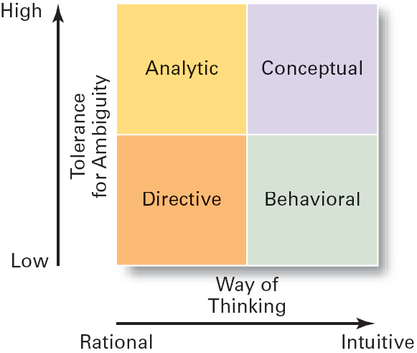
Dimensions of Decision-Making Styles
  Ways of thinking Tolerance for ambiguity
    Rational, orderly, and consistent Low tolerance: require consistency
    Intuitive, creative, and unique High tolerance: multiple thoughts
  Directive
    Use minimal information and
    consider few alternatives.
  Analytic
    Make careful decisions in unique
    situations.
  Conceptual
    Maintain a broad outlook and
    consider many alternatives in
    making decisions.
  Behavioral
    Avoid conflict by working well with others and being receptive to suggestions
6–<number>

Slide 21
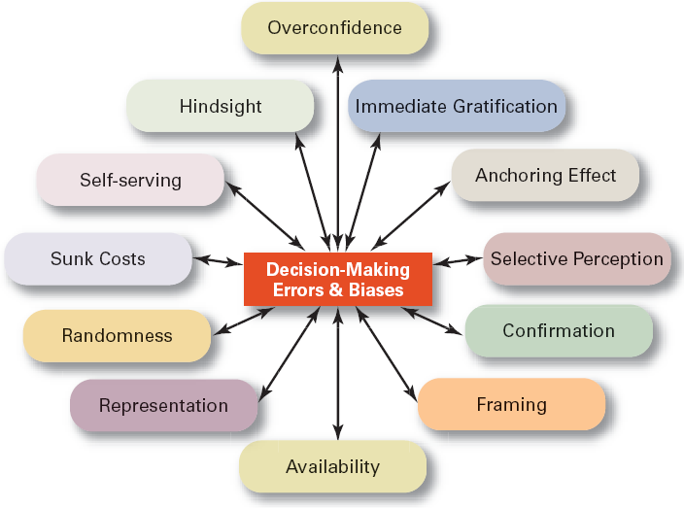
© 2007 Prentice Hall, Inc. All rights reserved.
6–<number>

Slide 22
TEST
Example:
On the evening of an important World Series game, your friend predicts that the Red Sox are going to win by a large margin. In fact, the Red Sox do end up winning the game, causing your friend to boast “I predicted it!
Example:
A high school basketball player makes a throw during the final seconds of a game and manages to make a basket. He attributes this to his skill at the game.
6–<number>

Slide 23
Case study
© 2007 Prentice Hall, Inc. All rights reserved.
6–<number>

Slide 24
In a public sector company, the workers are very lazy and do not do their allotted jobs in the stipulated time. The vice-president calls the manager and questions him about the situation. The manger says that the workers are bored with their jobs and their salary is not adequate. He is not willing to take a decision. What should the V.P. do? Who is at fault? Devise a solution.
© 2007 Prentice Hall, Inc. All rights reserved.
6–<number>

Slide 25
A software company was entering a new area of MIS. This company had a good reputation in the software areas. The company won a contract for MIS for a pharmaceutical company. The project was scheduled for completion in one year. But after 8 months a large part of the project was incomplete. Not completing the project on schedule will bring loss of face and litigation for the company. What should be the company do?
© 2007 Prentice Hall, Inc. All rights reserved.
6–<number>

